Slide 1

FOURIER SPECTRUM BASED CLASSIFICATION OF CANCEROUS GENES USING ANN

Slide 2
GROUP MEMBERS
KAYYALA PAVAN KUMAR
KOTTADA RAHUL
YALLAMARAJU SAI KIRAN
GUGULOTHU NAVEEN
KOKKIRALA ABHINAV

Slide 3
INTRODUCTION
Currently cancer is a frightened disease that plays a primary role triggering death entirely over the sphere.
It is caused due to abnormal proliferation of cells in a particular organ of the body with the potential to spread into other vital organs and infect to any other part of the body.
These cancer-causing genes known as oncogenes are either present in a person originally or they may be formed due to mutation of normal genes. There are many factors which may convert normal genes to mutated genes.
Cancer is mainly initiated due to the irregularities in the hereditary material of the converted cell. These irregularities may haphazardly occur due to mistakes in deoxyribonucleic acid (DNA) replication. Sometimes these irregularities are inborn and accordingly existing in all cells from natal.

Slide 4

DATA COLLECTION
CONVERSION OF GENE SEQUENCES INTO INDICATOR SEQUENCES(DIGITIZED REPRESENTATION OF GENE SEQUENCES)
PROCESSING OF INDICATOR SEQUENCES USING GENOMIC SIGNAL PROCESSING TECHNIQUES
EXTRACTION OF STATISTICAL PARAMETERS FROM PROCESSED SIGNALS
CLASSIFICATION OF GENE SEQUENCES AS CANCEROUS AND NON CANCEROUS GENE SEQUENCES BASED ON THE STATISTICAL PARAMETERS

Slide 5
DATABASE
We collected cancerous and non cancerous genes sequence from the given below link.
https://www.ncbi.nlm.nih.gov/genbank/
https://www.cancer.gov/about-nci/organization/ccg/research/structural-genomics/tcga

Slide 6
GSP ALGORITHM
The DFT xs[n] of the corresponding binary sequence is
Xs[k]=∑xs[n]e−j2πkn/N
Step 1: numerical mapping of the DNA sequence into indicator sequences based on Voss mapping technique . Which is two dimensional mapping.
Step 2: The DFT xATCG[n] of the corresponding Voss sequence is mapped using below formula
XATCG[k]=∑xATCG[n]e^(−j2πkn/N)
Step 3:Finding the PSD for the corresponding arrays of XATCG[n] and sujm up the all arrays.
Step 4:Designing the IIR low pass filter with butterworth approximation.
Step 5:Filter the existed PSD of the sequence using above designed filter.
Step 6:Extract the features from filter PSD sequence like
Mean
Median
Standard deviation
Variance
Kurtosis
Skewness

Slide 7
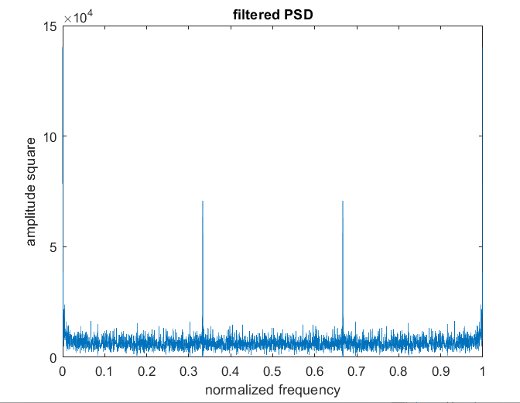
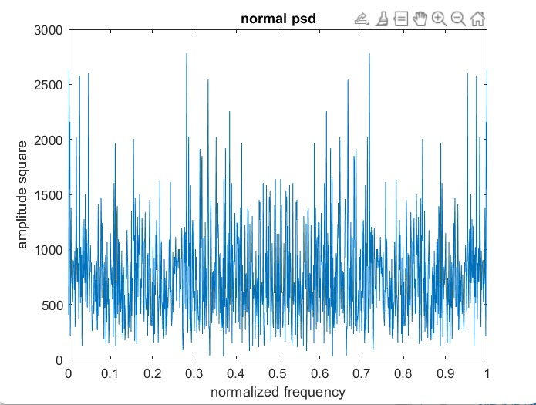
CANCEROUS

Slide 8
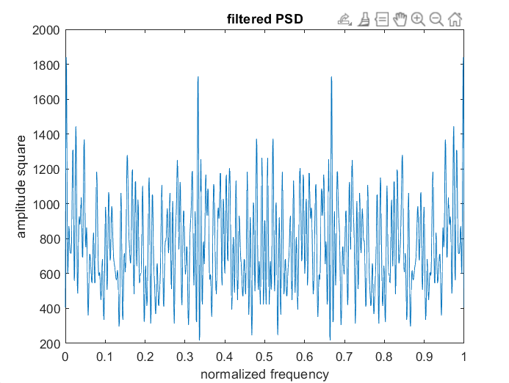
NON CANCEROUS

Slide 9

Classifier:
Features which are extracted from the above GSP method are passed through ANN classifier.
Split the dataset into training and testing datasets.
Train the ANN model with training datasets.
Test the ANN model with testing datasets.
Evaluate the performance of ANN model.

Slide 10
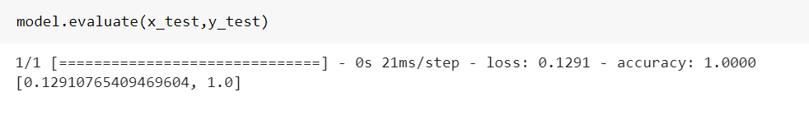
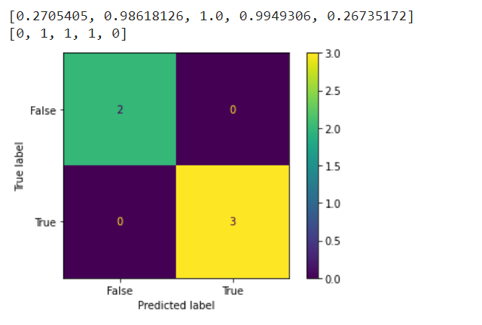
RESULTS
ACCURACY
CONFUSION MATRIX

Slide 11
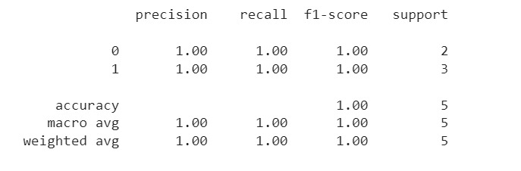
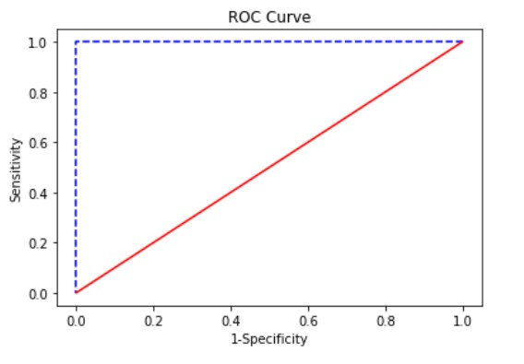
CLASSIFICATION REPORT
ROC Curve
Area Under Curve : 1.0

Slide 12
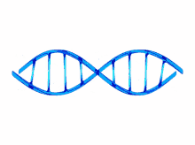
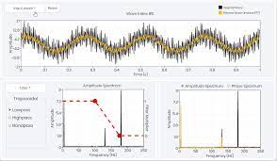
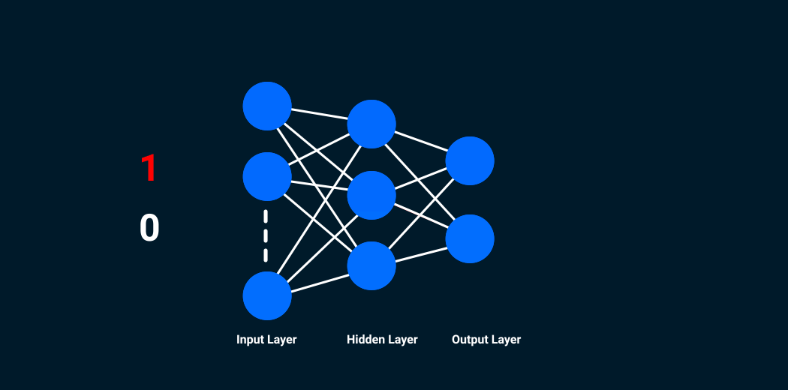
CONCLUSION
Genomic Signal processing methods detects the difference between cancerous and non cancerous gene sequences for lung, breast and ovarian cancer efficiently. Classification yielded a model with good accuracy but optimal model can be obtained only when above procedure is applied for all types of cancer.
CANCEROUS
OR
NON CANCEROUS

Slide 13
REFERENCE
https://ieeexplore.ieee.org/stamp/stamp.jsp?tp=&arnumber=6577034
https://reader.elsevier.com/reader/sd/pii/S0167739X18326645?token=D9138A274E5328FE173A02ACF4A265443ADA364436F5DE939E53713385C3722190EEC9836BB158F1A861EE3E7D6F73CA&originRegion=eu-west-1&originCreation=20221116175229
https://www.ijitee.org/wp-content/uploads/papers/v8i10/F3409048619.pdf

